Slide 1

LatentGuard: Adaptive Dual-Layer Web Application Firewall for Anomaly and Threat Detection
Syed Shaheer Khalid (SP23-BCT-048) | Javaria Maqbool (SP23-BCT-023)
Supervisor: Dr. Farhana Jabeen
Department of Cyber Security, COMSATS University Islamabad | BS Cyber Security 2023–2027

Slide 2
Contents:
1. Problem Statements
2. Scope Evaluation
3.Proposed Solution
4. Key modules
5. Use Case Diagram
6. How we Gathered Requirements
6.1 Mockups
6.2. Events
6.2.1 Required derived from Events
7. Non-functional Requirements

Slide 3

1. Problem Statement — Why Are We Building This?
The Problem
Who Is Affected
Traditional WAFs cannot detect zero-day and polymorphic attacks – threats without pre-existing signatures.
High false‑positive rates disrupt legitimate traffic and increase operational overhead.
No automated mechanism to convert newly observed attack patterns into deployable rules.
Security teams require constant manual tuning—time intensive and error prone.
Security administrators facing alert fatigue
Web application owners seeking uninterrupted availability
DevOps teams responsible for deployment stability
Organizations operating APIs in hostile threat environments

Slide 4

2. Industry Evaluation Feedback & Revisions
Feedback Received
Changes Made
Needed to incorporate/build up on open-source WAF (Modsecurity)
The issue of acquiring good datasets for model training.
LLM-generated rules risk deploying malicious or incorrect rules without oversight — a validation gate is essential.
Revised system architecture to position ModSecurity as the rule engine, with AI as a complementary layer
Finalized training datasets: CSIC 2010, CIC-IDS2017, CSE-CIC-IDS2018, HTTPParams
All AI‑generated rules now require administrator approval before going live.

Slide 5
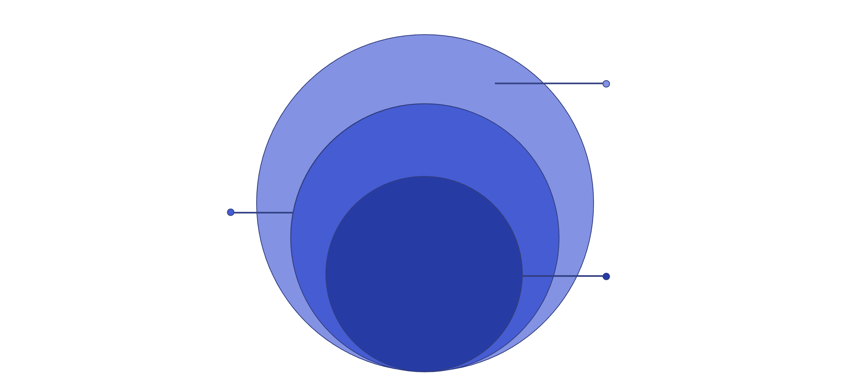
3. Proposed Solution — LatentGuard
Closed Loop
LLM rule gen, human review, deploy
AI Detection
Autoencoder scoring and HDBSCAN clustering
Rule-Based Filter
ModSecurity, OWASP CRS, AI rules, threat intel
Effectiveness highlights:
Detects known AND unknown attacks through hybrid rule + anomaly strategy.
Reduces false positives via multi‑stage consensus (recon error + clustering + rules).
Self‑improves: observed patterns are synthesized into candidate rules and routed through HITL validation.

Slide 6
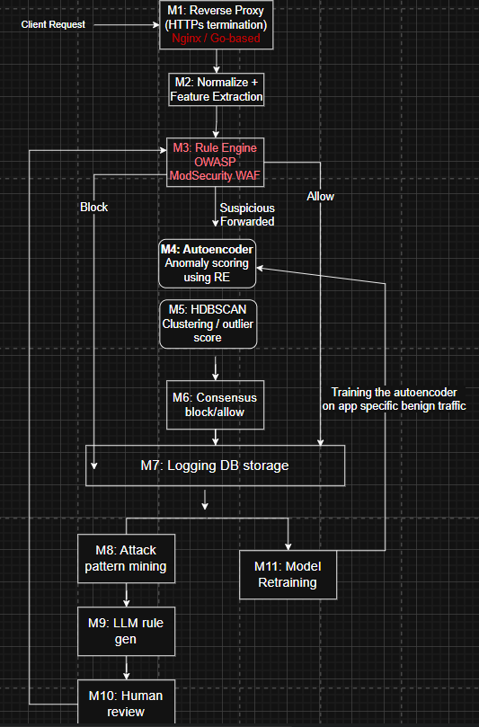
3. Updates w.r.t Evaluation — LatentGuard
M3 upgraded: ModSecurity (OWASP CRS) now serves as primary rule-based engine, complemented by dual-layer AI
M1 technology decision: Nginx (battle-tested, scalable) vs. Go-based proxy (lower latency, customizable) – based on project requirements.
Assessing important datasets required in the implementation of this project.

Slide 7






4. Key Modules
Reverse Proxy Interception
Rule‑Based Filtering Engine
Autoencoder Anomaly Detection
HDBSCAN Clustering Validation
Go‑based traffic capture with TLS termination and early request extraction.
ModSecurity + OWASP CRS augmented with AI‑synthesized candidate rules.
Reconstruction error scoring trained on benign traffic to flag anomalies.
Latent‑space clustering to validate anomalies and suppress spurious alerts.
Multi‑Signal Consensus Engine
LLM Rule Generation + HITL
Weighted voting across rules, recon error, and clustering for final decision.
Pattern mining → LLM synthesizes candidate rules → administrator approval loop.

Slide 8

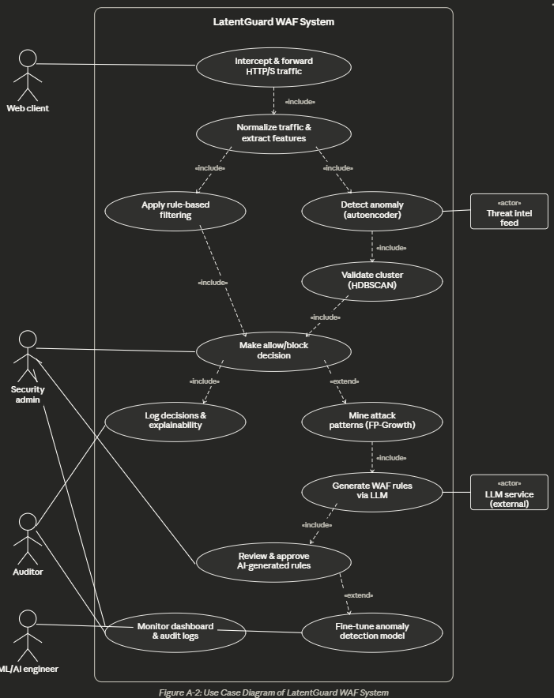
5. Use Case Diagram
Actors:
🔵 Web Client — initiates HTTP/S requests to the protected application
🔵 Security Admin — reviews AI-generated rules, monitors decisions & explainability logs
🔵 Auditor / ML Engineer — monitors dashboard, fine-tunes anomaly detection model
🔵 Threat Intel Feed / LLM Service — external actors feeding intelligence into the system
Key Use Cases:
Traffic interception → normalization → dual-layer detection (autoencoder + HDBSCAN)
Consensus engine makes final allow/block decision with full explainability
Attack patterns mined → LLM generates rules → human approval before deployment

Slide 9
6. How We Gathered Requirements
Mockup‑Based Analysis
Event Based Analysis
UI wireframes produced for each feature; functional requirements derived from screen elements and user flows.
In this we analyzed diff events and based on those events we gathered
our Requirements
Justification: Directly ties UI expectations to system behavior and acceptance criteria.

Slide 10
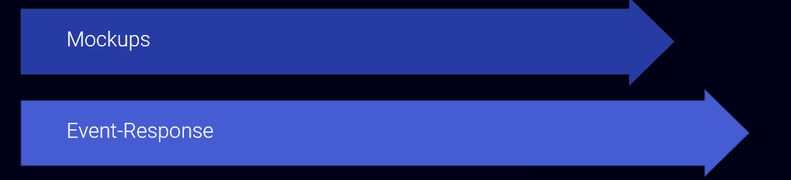
6. How We Gathered Requirements
Brief breakdown:
Mockups — Map user actions (Login, Dashboard, Rule Review) to expected system responses.
Event‑Response Tables — Define triggers, system action, pre/post state, and error handling for key events (10 primary events).

Slide 11
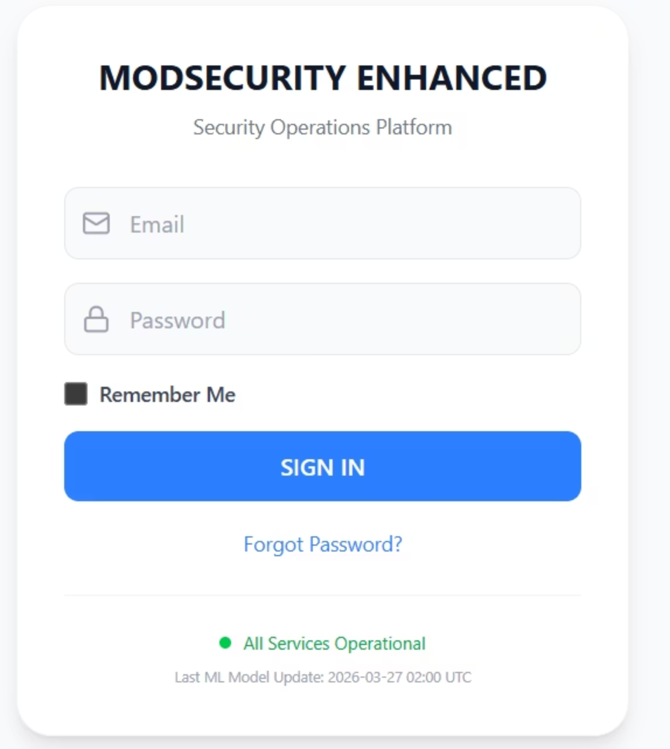
6.1 Mockups & Functional Requirements
Mockup M1 – Login & Authentication Page
Functional Requirements Derived from Mockup M1 –Login Page
Feature (derived from UI) | Functional Requirement (FR-ID: Statement) | Business Rule
User Sign-In | FR1.1: The system shall allow authenticated users to access the dashboard by providing valid email and password credentials. | Email must follow standard format. Password must be at least 8 characters with mixed case, numbers, and special characters.
User Authentication | FR1.2: The system shall validate credentials against stored records in the authentication database. | Accounts shall be locked for 15 minutes after 5 consecutive failed login attempts.
Password Recovery | FR1.3: The system shall allow users to initiate password recovery when requested. | Only registered users with verified email addresses can request password recovery.
Remember Me Option | FR1.4: The system shall allow users to stay signed in on the same device by selecting "Remember Me". | Session shall remain active for 30 days or until user explicitly logs out.

Slide 12
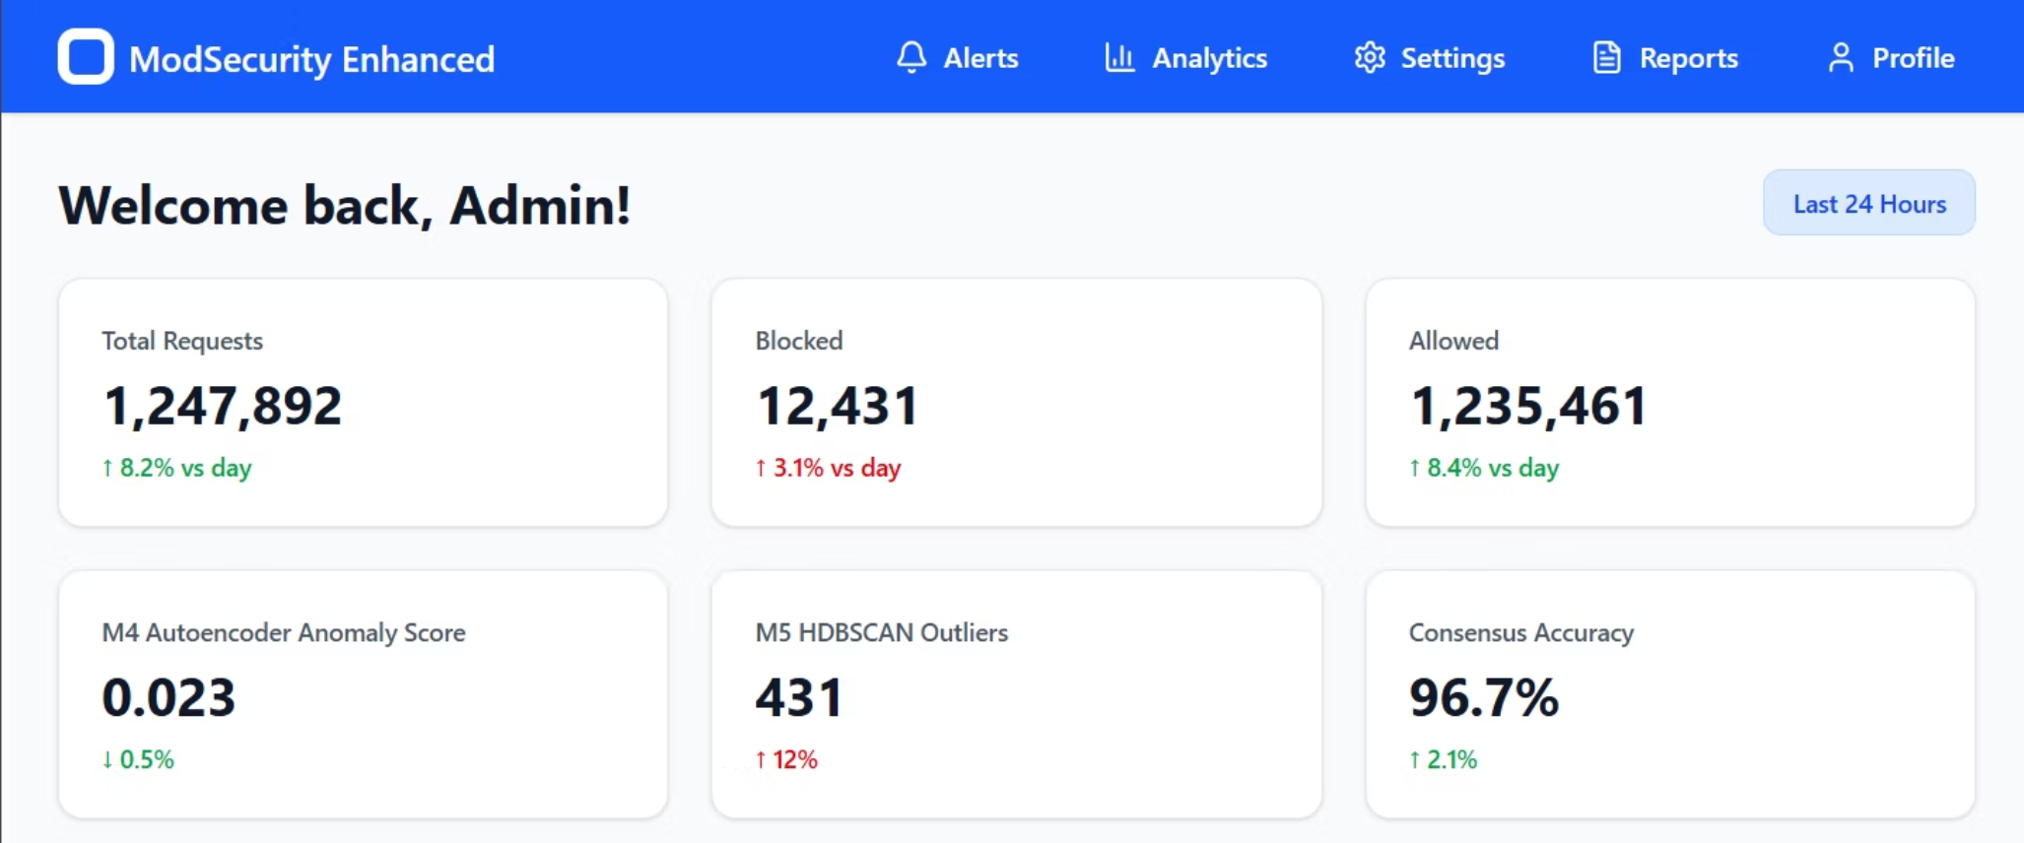
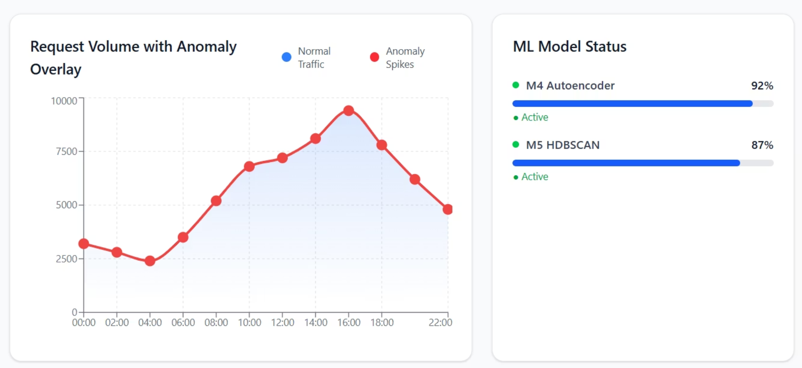
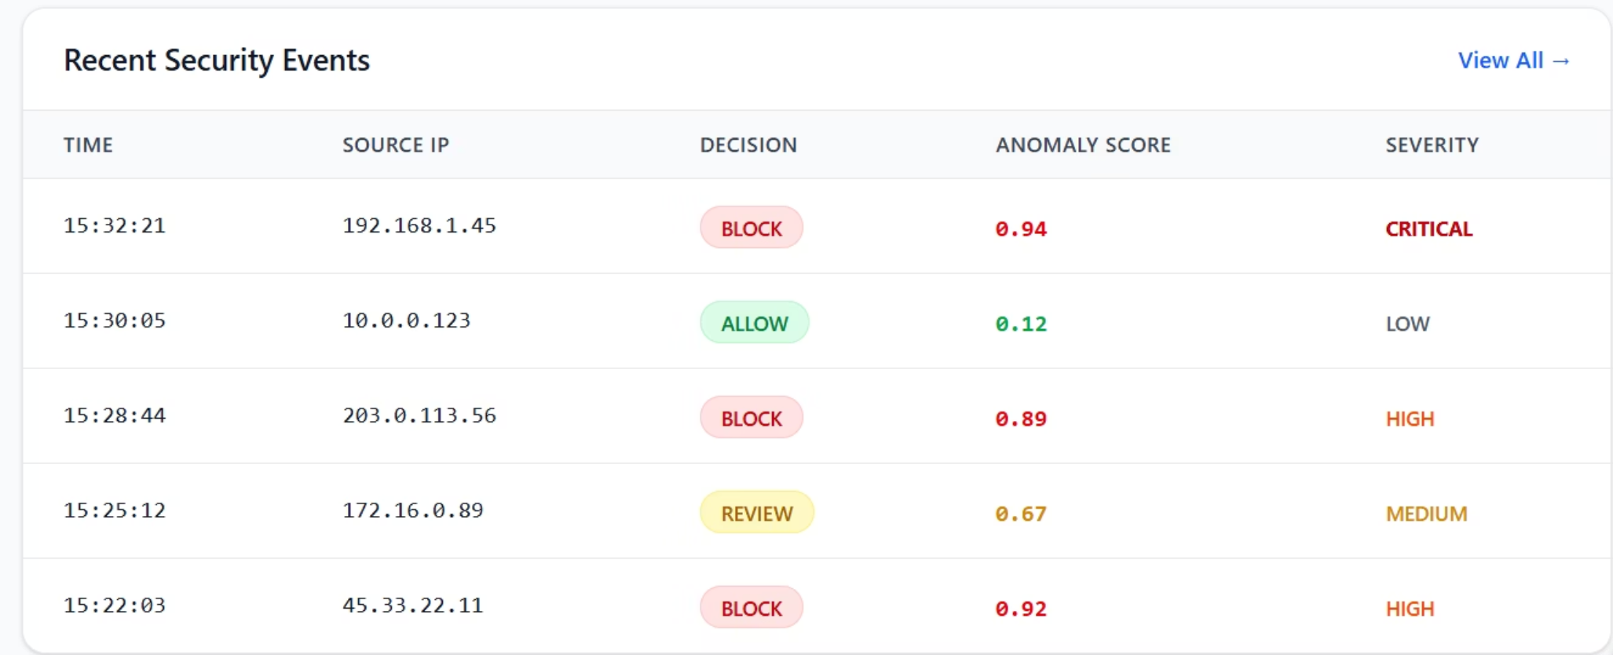
Mockup M2 – Dashboard Overview

Slide 13
Mockup M2 – Dashboard Overview
Feature (derived from UI) | Functional Requirement (FR-ID: Statement) | Business Rule
Navigation Menu | FR2.1: The system shall provide access to key sections (Alerts, Analytics, Settings, Reports, Profile) through a top navigation bar. | Menu items shall be displayed based on user role (Admin, Analyst, Viewer).
Personalized Welcome | FR2.2: The system shall display a personalized welcome message showing the authenticated user's name. | User name shall be retrieved from the authenticated session.
Request Metrics | FR2.3: The system shall display total requests, blocked count, and allowed count with percentage change indicators. | Metrics shall update in real-time with data aggregated from the last 24 hours and compared to previous period.
Traffic Timeline | FR2.4: The system shall display a graphical timeline of traffic with anomaly score overlay. | Timeline shall refresh every 5 minutes with data from the logging database (M7).
ML Model Status | FR2.5: The system shall display real-time status and performance metrics for M4 (Autoencoder) and M5 (HDBSCAN) models. | Model status shall indicate current load, accuracy, and any degradation alerts.
Recent Events Table | FR2.6: The system shall display a list of recent security events including timestamp, source IP, decision, and anomaly score. | Events shall be sorted by most recent timestamp, showing maximum 10 rows per page.
View All Link | FR2.7: The system shall allow navigation to the complete logs view from the recent events section. | Clicking "View All" shall redirect to the Logs & Audit page with current filter context.

Slide 14

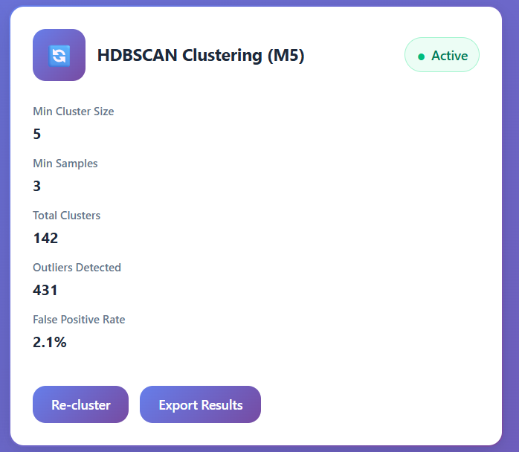
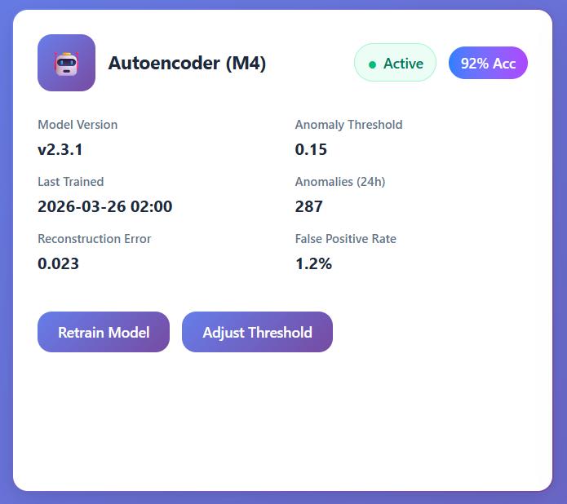
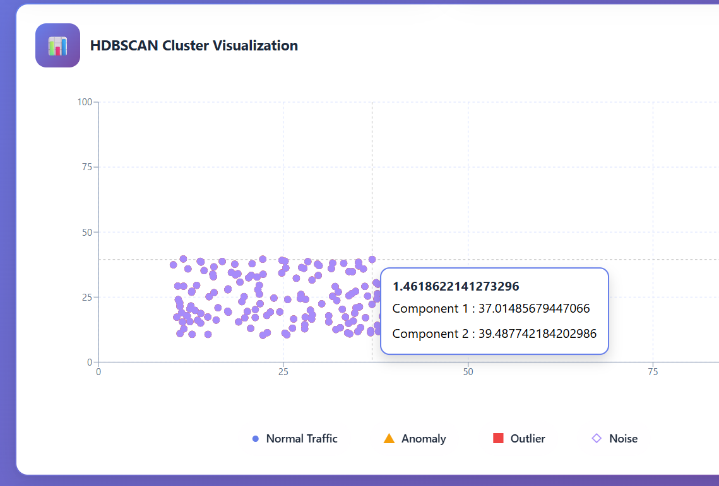
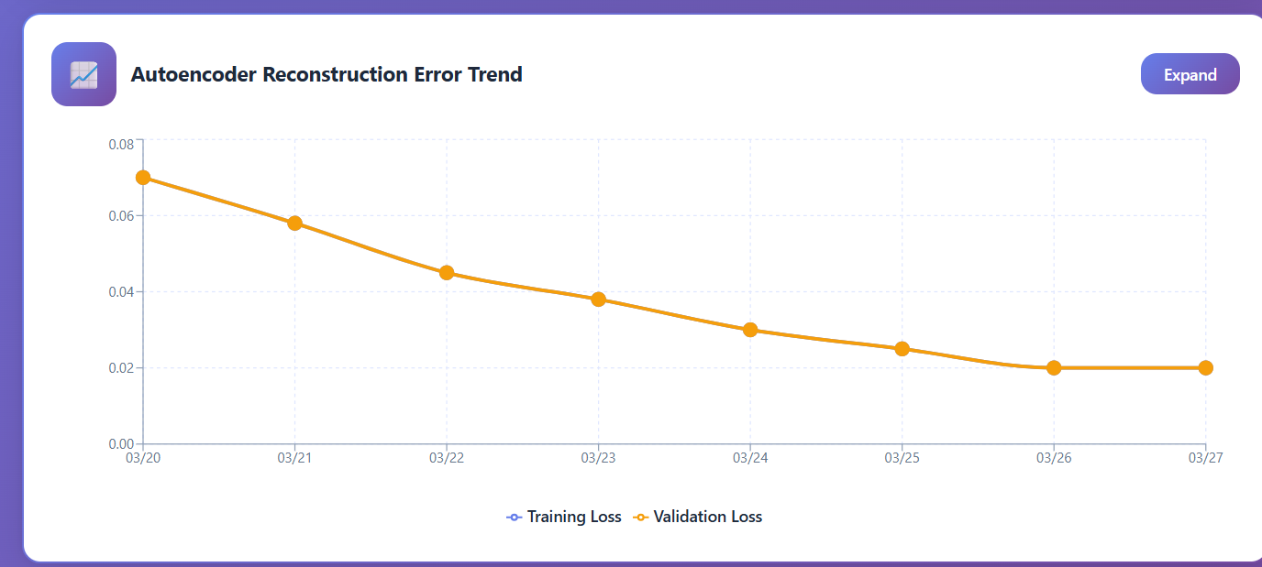
Mockup M3 – Anomaly Detection (M4 & M5)
Functional Requirements

Slide 15
Mockup M3 – Anomaly Detection (M4 & M5)
Feature (derived from UI) | Functional Requirement (FR-ID: Statement) | Business Rule
Autoencoder Status Display | FR3.1: The system shall display current status, version, and performance metrics for the M4 Autoencoder model. | Status indicators shall show Active, Training, Degraded, or Offline states.
Retrain Model Button | FR3.2: The system shall allow administrators to initiate retraining of the autoencoder on new benign traffic data. | Retraining shall only be performed during scheduled maintenance windows or when model degradation exceeds 5%.
Adjust Threshold Control | FR3.3: The system shall allow administrators to modify the anomaly detection threshold for the autoencoder. | Threshold range shall be 0.01 to 0.50 with default 0.15. Changes shall be logged for audit.
HDBSCAN Configuration | FR3.4: The system shall display and allow modification of HDBSCAN clustering parameters (min cluster size, min samples). | Parameter changes shall trigger re-clustering of recent data.
Cluster Visualization | FR3.5: The system shall provide a 2D visualization of clusters with color-coded points representing normal traffic, anomalies, outliers, and noise. | Visualization shall update when re-clustering is performed.
Error Trend Graph | FR3.6: The system shall display a historical trend of autoencoder reconstruction error over the last 7 days. | Graph shall support drill-down to hourly granularity.

Slide 16
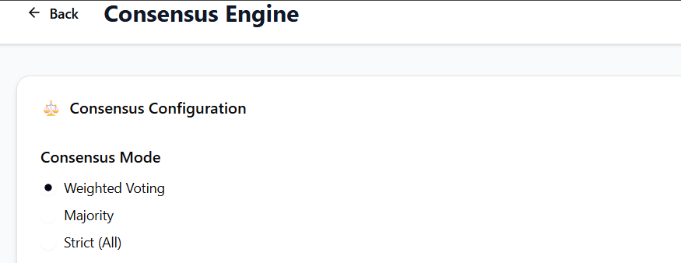
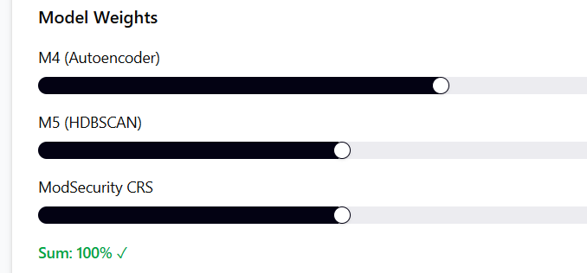
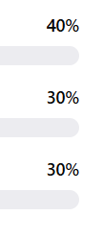
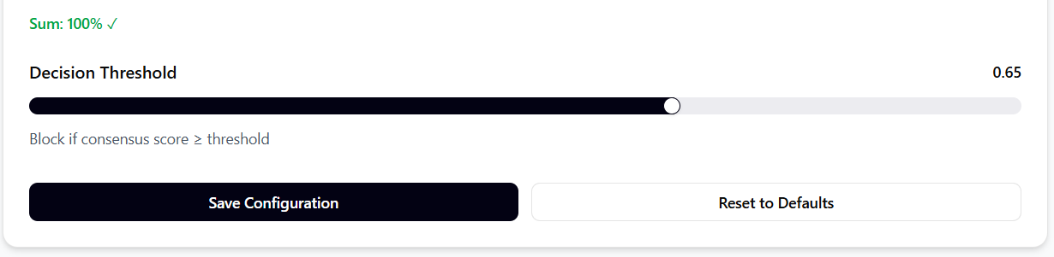
Mockup M4 – Consensus Engine (M6)

Slide 17
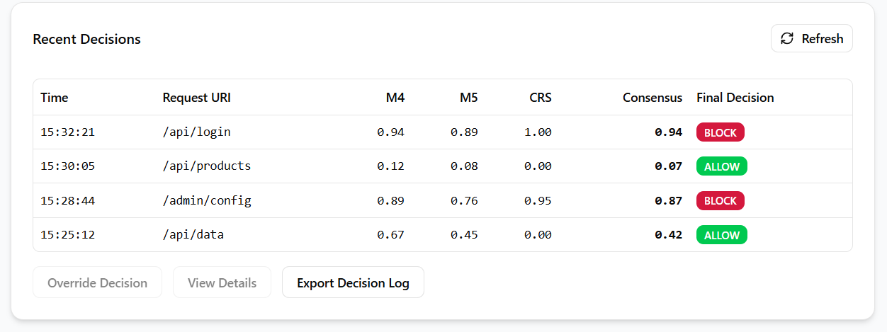
Mockup M4 – Consensus Engine (M6)

Slide 18
Mockup M4 – Consensus Engine (M6)
Feature (derived from UI) | Functional Requirement (FR-ID: Statement) | Business Rule
Consensus Mode Selection | FR4.1: The system shall support three consensus modes: Weighted Voting, Majority, and Strict (all models must agree). | Mode selection shall persist across system restarts and be logged for audit.
Weight Configuration | FR4.2: The system shall allow administrators to assign weight percentages to each detection model (M4, M5, ModSecurity CRS). | Sum of all weights must equal 100%. Weight changes shall require confirmation.
Decision Threshold | FR4.3: The system shall allow configuration of the decision threshold for block/allow determination. | Threshold shall be between 0.00 and 1.00. Default threshold is 0.65.
Decisions Table | FR4.4: The system shall display recent decisions with individual model scores and consensus result. | Table shall show last 50 decisions by default with pagination support.
Override Decision | FR4.5: The system shall allow administrators to manually override automated decisions. | Override shall be logged with administrator identity, reason, and timestamp.
Export Logs | FR4.6: The system shall allow exporting decision logs in CSV and JSON formats. | Export shall include all decision parameters and override history.
IF WE ZOOM IN

Slide 19
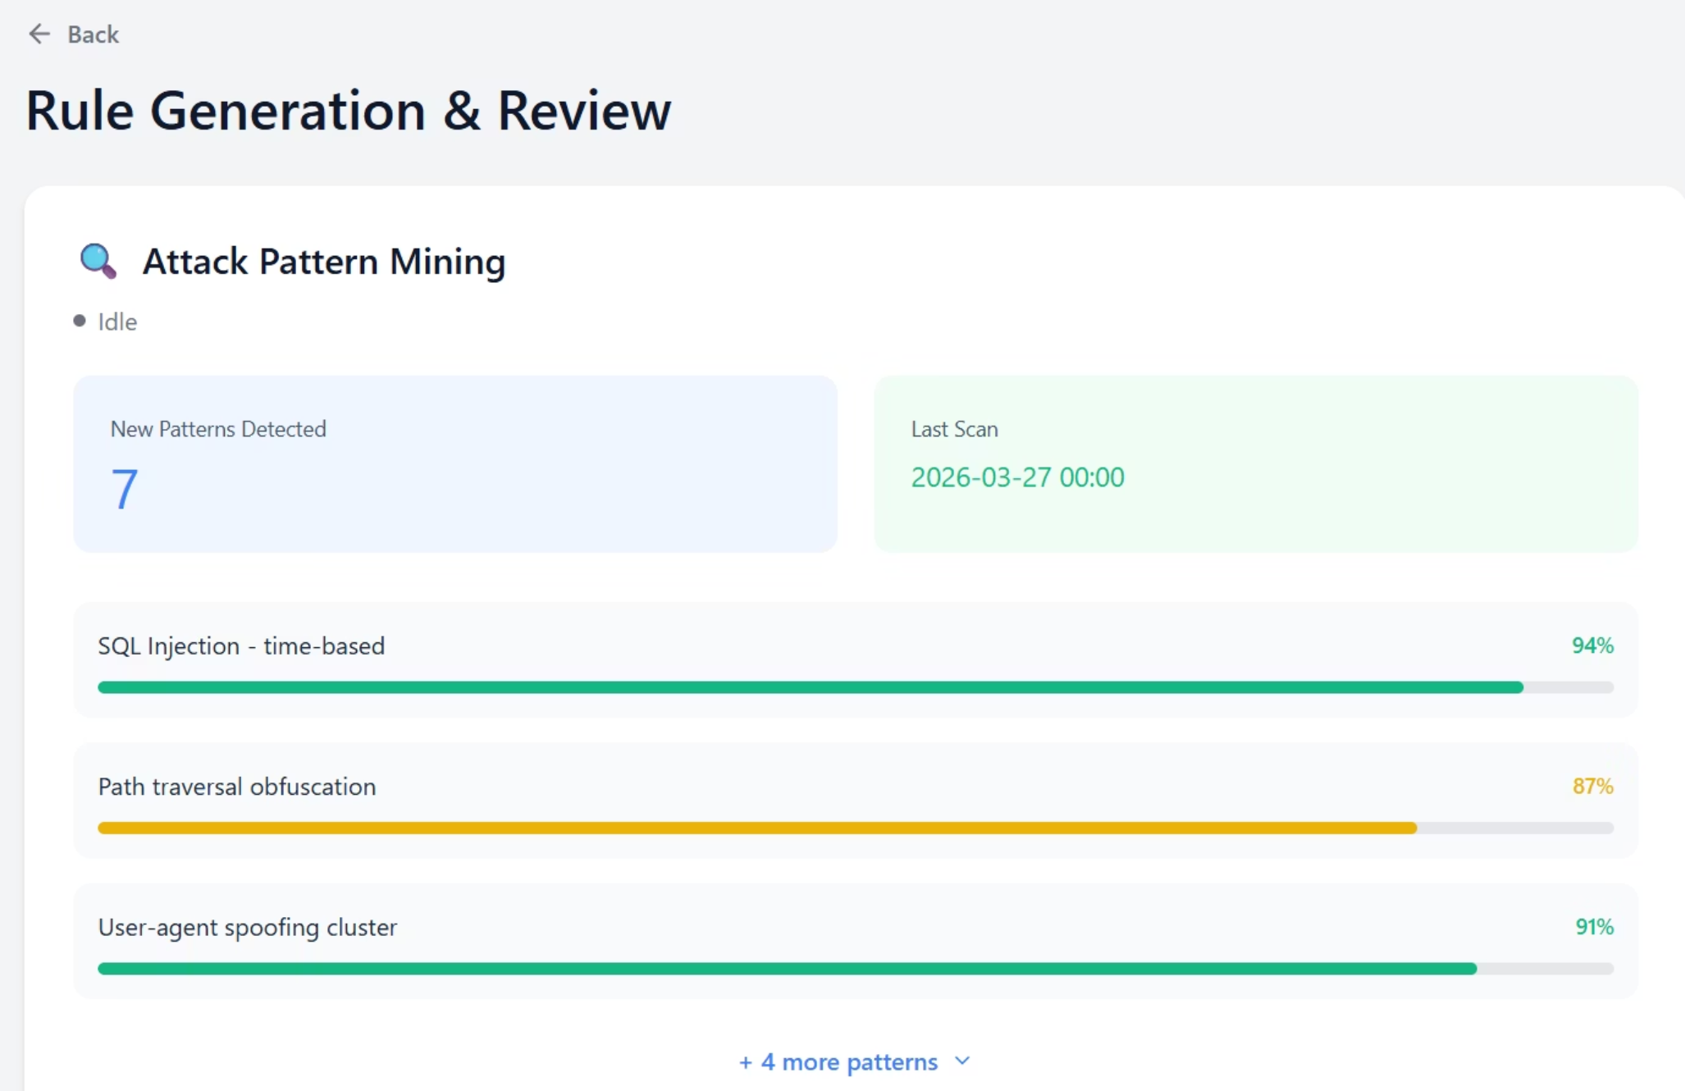
Mockup M5 – LLM Rule Generation & Human Review (M8, M9, M10)
Feature (derived from UI)
Functional Requirement (FR-ID: Statement)
Business Rule
Pattern Mining Status
FR5.1: The system shall display current status of attack pattern mining process (M8).
Status shall show Idle, Running, Completed, or Failed states.
New Patterns Display
FR5.2: The system shall list newly detected attack patterns with confidence scores.
Patterns with confidence below 70% shall be flagged for review only, not auto-processed.
Run Pattern Mining
FR5.3: The system shall allow manual initiation of attack pattern mining on recent blocked traffic.
Mining process shall analyze last 24 hours of blocked requests.
LLM Rule Generation
FR5.4: The system shall generate ModSecurity-compatible rules from validated attack patterns using LLM.
Generated rules shall follow ModSecurity CRS syntax standards.
Rule Preview
FR5.5: The system shall display generated rules with metadata including confidence score, expected false positive rate, and severity.
Rules must be reviewed by human before deployment.
Human Review Queue
FR5.6: The system shall maintain a queue of pending rules requiring human review.
Rules remain pending until explicitly accepted, edited, or rejected by an administrator.
Bulk Operations
FR5.7: The system shall allow bulk approval or rejection of multiple rules.
Bulk operations shall require confirmation with audit logging.

Slide 20
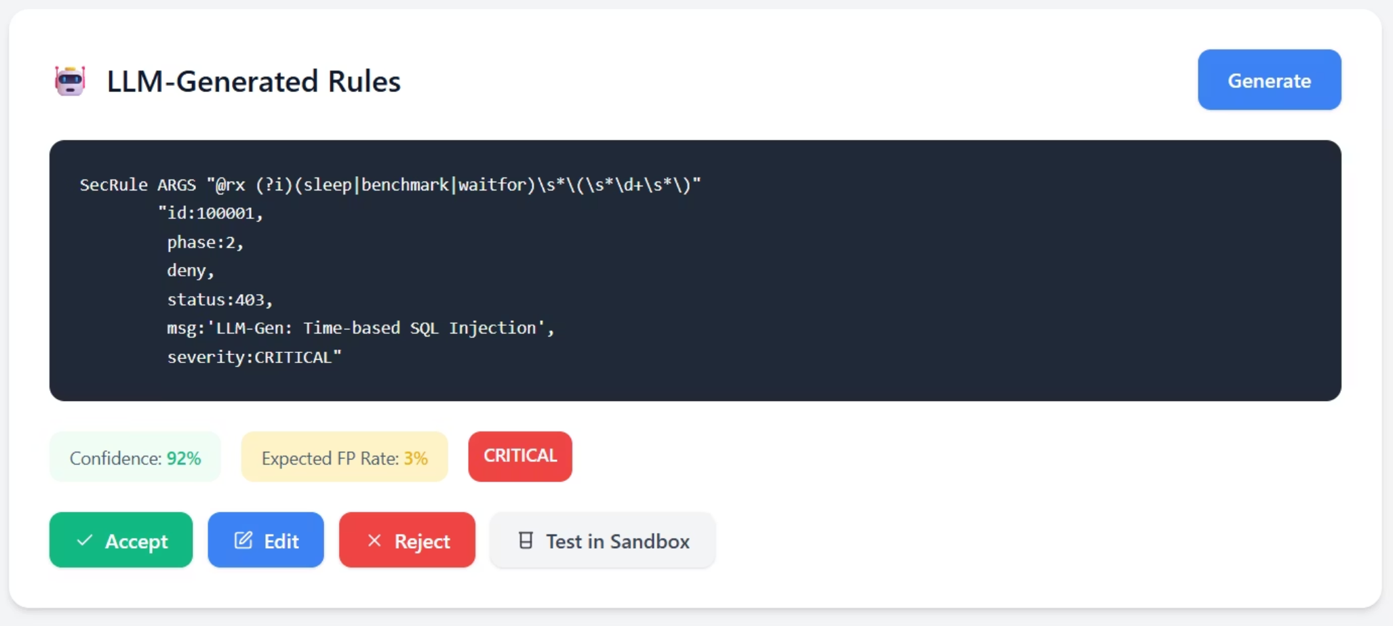
Mockup M5 – LLM Rule Generation & Human Review (M8, M9, M10)

Slide 21
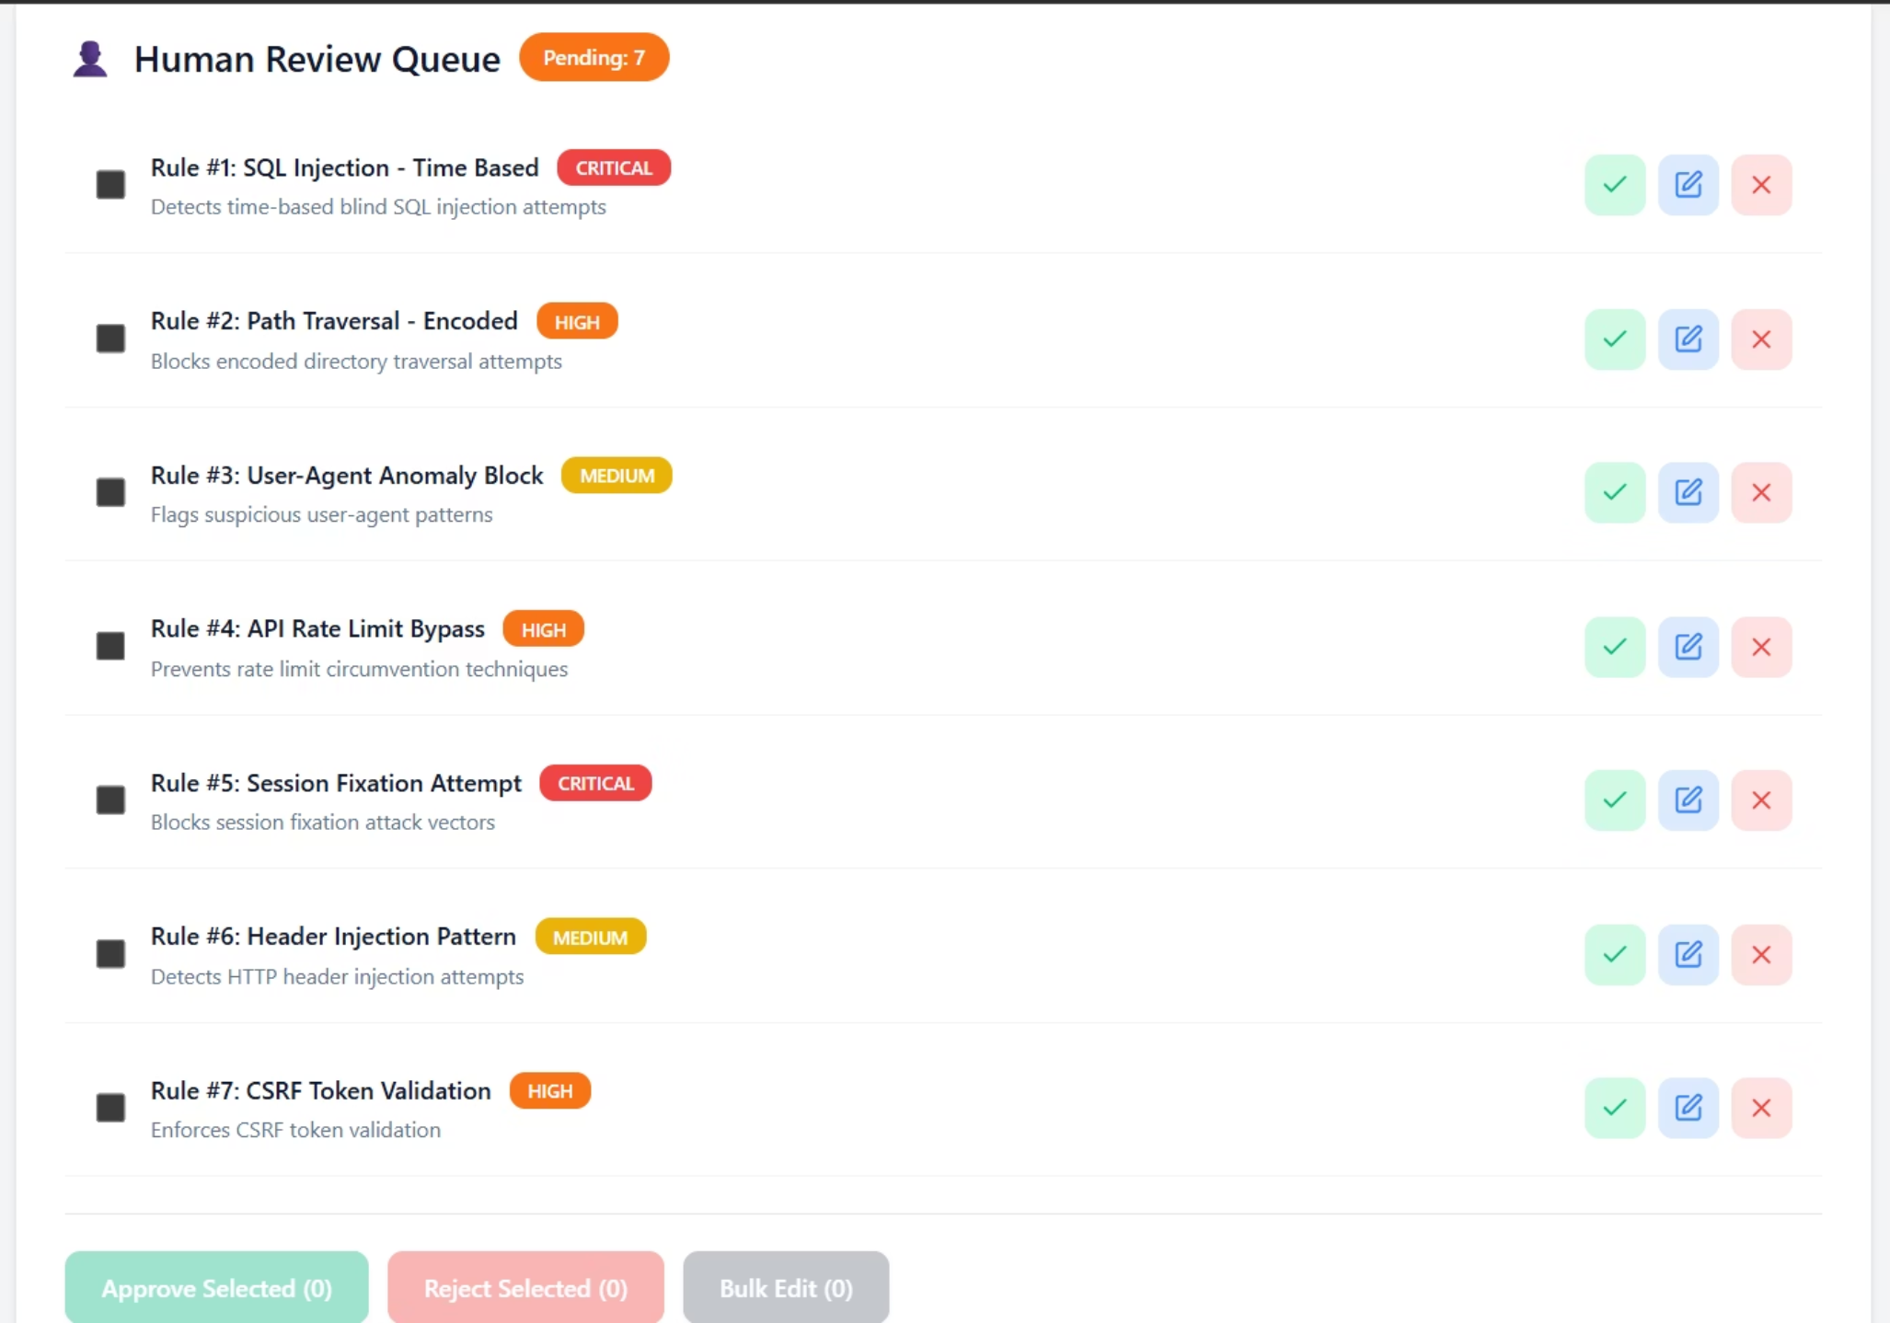
Mockup M5 – LLM Rule Generation & Human Review (M8, M9, M10)

Slide 22
Mockup M5 – LLM Rule Generation & Human Review (M8, M9, M10)
Feature (derived from UI) | Functional Requirement (FR-ID: Statement) | Business Rule
Pattern Mining Status | FR5.1: The system shall display current status of attack pattern mining process (M8). | Status shall show Idle, Running, Completed, or Failed states.
New Patterns Display | FR5.2: The system shall list newly detected attack patterns with confidence scores. | Patterns with confidence below 70% shall be flagged for review only, not auto-processed.
Run Pattern Mining | FR5.3: The system shall allow manual initiation of attack pattern mining on recent blocked traffic. | Mining process shall analyze last 24 hours of blocked requests.
LLM Rule Generation | FR5.4: The system shall generate ModSecurity-compatible rules from validated attack patterns using LLM. | Generated rules shall follow ModSecurity CRS syntax standards.
Rule Preview | FR5.5: The system shall display generated rules with metadata including confidence score, expected false positive rate, and severity. | Rules must be reviewed by human before deployment.
Human Review Queue | FR5.6: The system shall maintain a queue of pending rules requiring human review. | Rules remain pending until explicitly accepted, edited, or rejected by an administrator.
Bulk Operations | FR5.7: The system shall allow bulk approval or rejection of multiple rules. | Bulk operations shall require confirmation with audit logging.

Slide 23
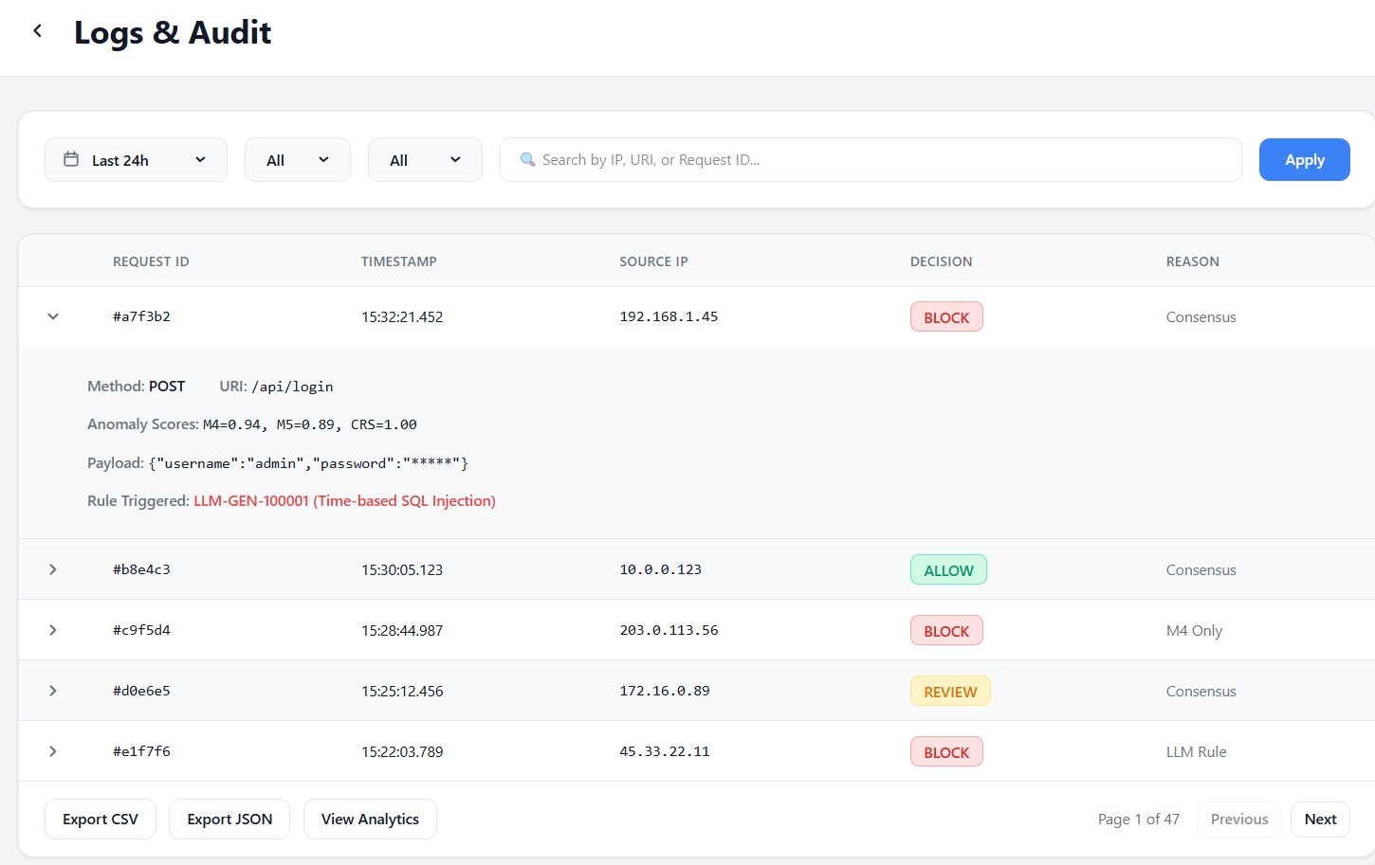
Mockup M6 – logging & audit:

Slide 24
Mockup M6 – logging & audit:
Feature (derived from UI) | Functional Requirement (FR-ID: Statement) | Business Rule
Date Range Filter | FR6.1: The system shall allow filtering logs by date range (preset and custom). | Log retention period shall be 90 days for detailed logs, 365 days for summarized metrics.
Decision Filter | FR6.2: The system shall allow filtering logs by decision type (Block, Allow, Review). | Filter options shall include ALL, BLOCK, ALLOW, and REVIEW.
Search Functionality | FR6.3: The system shall allow searching logs by IP address, URI, or request ID. | Search shall support partial matching and wildcard characters.
Expandable Row Details | FR6.4: The system shall allow expanding log entries to view full request details, anomaly scores, and triggered rules. | Expandable section shall show complete request/response details.
Export Functionality | FR6.5: The system shall allow exporting filtered logs in CSV and JSON formats. | Exports shall be limited to 100,000 rows per request with async notification.
Pagination | FR6.6: The system shall support pagination with configurable rows per page (default 25). | Page navigation shall maintain current filter settings.

Slide 25
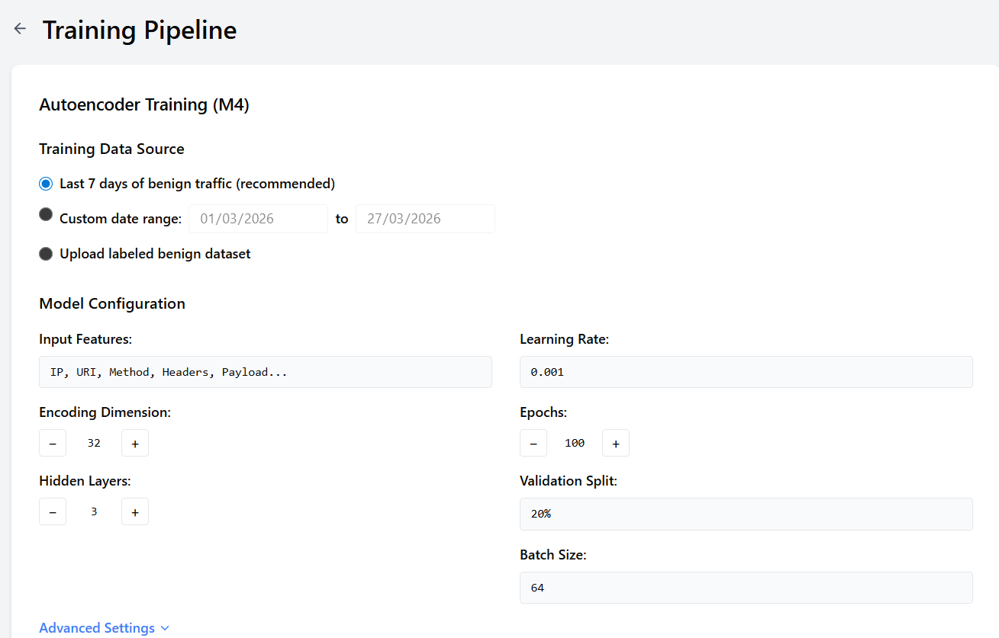
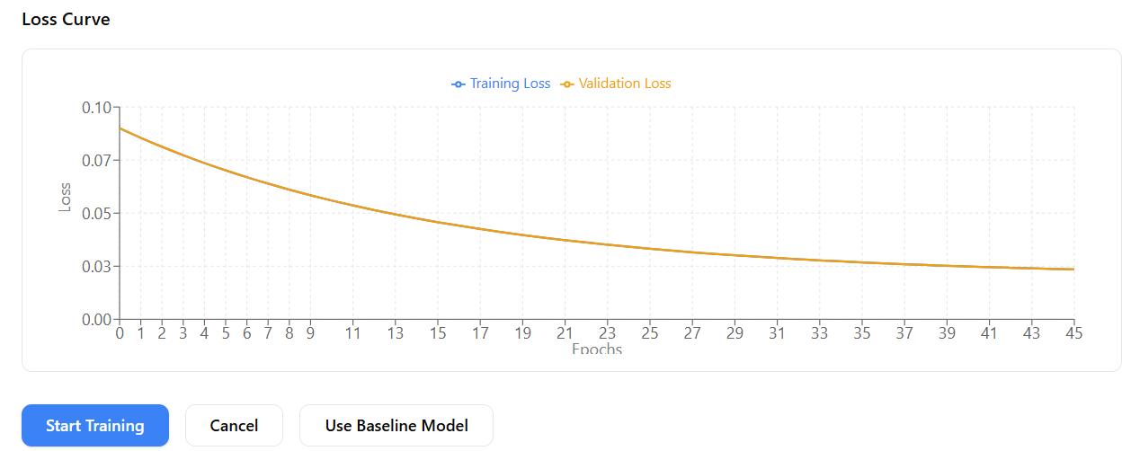
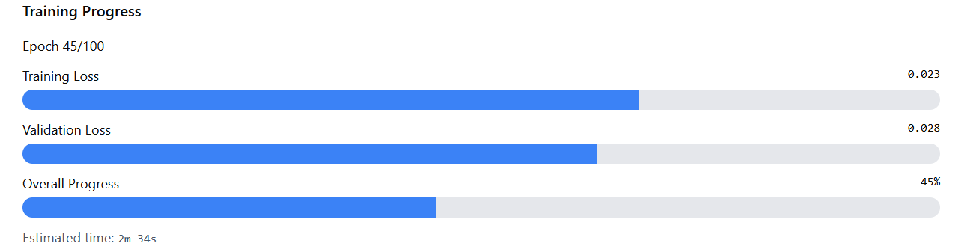
Mockup M7 – Training Pipeline (Autoencoder training)

Slide 26
Mockup M7 – Training Pipeline (Autoencoder training)
Feature (derived from UI) | Functional Requirement (FR-ID: Statement) | Business Rule
Data Source Selection | FR7.1: The system shall allow selection of training data source from recent benign traffic, custom date range, or uploaded dataset. | Training data must be labeled as benign (no attacks) before use.
Model Configuration | FR7.2: The system shall allow configuration of autoencoder hyperparameters (encoding dimension, hidden layers, learning rate, epochs). | Configuration changes shall be validated for reasonable ranges.
Training Progress Display | FR7.3: The system shall display real-time training progress with loss values and estimated completion time. | Training shall support cancellation with automatic model rollback to previous version.
Loss Curve Visualization | FR7.4: The system shall display training and validation loss curves during and after training. | Loss curves shall be available for comparison across training runs.
Model Deployment | FR7.5: The system shall allow deployment of trained model as active inference engine after validation. | New model shall be validated against holdout test set before deployment.
Baseline Model Fallback | FR7.6: The system shall allow reverting to baseline pre-trained model if new model underperforms. | Baseline model shall be preserved as fallback option.

Slide 27
6.2 System Events Overview
Based on components M4 through M10, the following key events drive the WAF's behavior —
from initial traffic intake to model retraining and human-in-the-loop rule approval.
01
02
Traffic Received
M4 Anomaly Detection Complete
HTTP request arrives from external user/client
Autoencoder finishes scoring the request
03
04
M5 Outlier Detection Complete
Consensus Decision Reached
HDBSCAN finishes analyzing the request
All models have voted; final decision made
05
06
Attack Pattern Detected
LLM Rule Generated
Pattern miner identifies a new attack type
LLM creates a new ModSecurity rule from a pattern
07
08
Rule Approved / Rejected
Model Training Complete
Human admin reviews and decides on the rule
Autoencoder finishes retraining on new data
09
10
False Positive Detected
System Performance Degraded
Admin marks a blocked request as harmless
Model accuracy drops below acceptable levels

Slide 28
6.2 Event–Response Table
Table A-5: Event–Response Table for Enhanced ModSecurity WAF System
Event Name | What Triggers It | Where It Comes From | System State (Before) | What the System Does | System State (After) | What If Something Goes Wrong
Traffic Received | HTTP request arrives | External user/client | Waiting for request | Extracts request data, logs it, sends to M4 & M5 | Under analysis | Log error and return 400 if malformed
M4 Anomaly Detection Complete | Autoencoder finishes | M4 Module | Waiting for ML result | Calculate anomaly score, flags if above threshold | Score stored | Fallback to ModSecurity
M5 Outlier Detection Complete | Clustering completes | M5 Module | Waiting for result | Assigns outlier score and cluster | Score stored | Assign neutral score (0.5)
Consensus Decision Reached | All models respond | M6 Engine | Waiting for decision | Computes weighted score, allows/blocks request | Decision logged | Fallback to ModSecurity
Attack Pattern Detected | Pattern identified | M8 Module | Monitoring logs | Extracts and stores attack pattern | Ready for rule generation | Flag for manual review
LLM Rule Generated | Pattern processed | M9 Module | Waiting for rule | Generates rule and adds to review queue | Pending review | Mark for manual creation
Rule Approved/Rejected | Admin reviews | M10 Module | In review queue | Approve → deploy, Reject → archive | Rule active or archived | Rollback if deployment fails
Model Training Complete | Training finishes | M4 Module | Training in progress | Validates and deploys if improved | Model updated or unchanged | Revert to previous model
False Positive Detected | Admin flags request | M7 Module | Running normally | Updates dataset and adjusts model | Dataset updated | Skip if data issue
System Performance Degraded | Accuracy drops | Monitoring Module | Running normally | Alerts admin, switches to safe mode | Safe mode active | Disable ML if needed

Slide 29
6.2.1 Derived Functional Requirements
Table A-6: Functional Requirements Derived from Event–Response Table
FR-MOD-1 — Traffic Parsing
FR-M4-1 — Anomaly Scoring
Extract IP, URI, method, headers, and payload from every HTTP request. Reject malformed requests with a 400 error before ML analysis.
Calculate reconstruction error via autoencoder; flag scores above 0.15 as suspicious. Threshold adjustable between 0.01–0.50 by admins.
FR-M5-1 — Outlier Detection
FR-M6-1 — Consensus Engine
Assign outlier scores using HDBSCAN targeting small clusters of unusual traffic. All outlier-flagged requests count toward the final consensus decision.
Combine scores: M4 40%, M5 30%, ModSecurity 30%. Block any request with a final score ≥ 0.65. Weights and threshold are admin-configurable.
FR-M8-1 — Pattern Mining
FR-M9-1 — LLM Rule Generation
Scan blocked traffic daily for new attack patterns with confidence scores. Only patterns with ≥ 70% confidence are automatically forwarded to the LLM.
Generate ModSecurity rules from validated patterns. Every rule must pass a syntax check before entering the review queue.
FR-M10-1 — Rule Review Queue
FR-M4-2 / FR-M7-1 / FR-MON-1
Maintain a human-review queue. No rule deploys without explicit admin approval. Rules in queue are never live.
Admins retrain autoencoder; new model auto-deploys only if false positives improve. False positive records retained 1 year. Alerts fire if FP rate > 5% or accuracy < 90%.

Slide 30
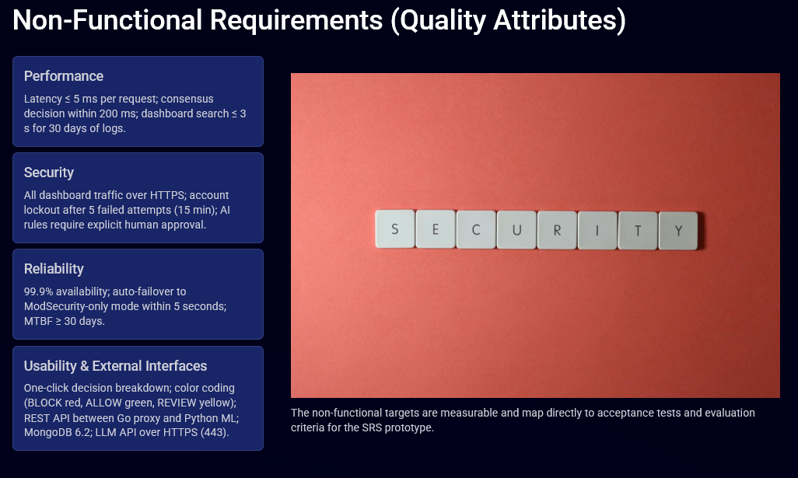

Slide 31
Thank You

